Slide 1
Battle of neighborhoods
Final project
Fabián Camargo

Slide 2
The problem
Break and enter crime become a nighmare for commercials in Toronto. Criminals know how to get into and nothing can stop them.
A security technology company has developed a new kind of security doors and surveillance system that will can avoid that kind of crime in Toronto. The company wants to focus on commercial located in neighborhoods that have presented breaking and entering in 2019, that information is part of tha market study. The study need information from the last year in order to know the neighborhoods where occur that kind of crime.
Police department have a lot of information abour crimes in Toronto. In this problem, We will use crime data and foursquare´s data in order to design a comercial plan.

Slide 3
Information source
Toronto police open data about crimes: https://data.torontopolice.on.ca/pages/catalogue
Location and kind of potential customers in Toronto: Foursquare API
Toronto neighborhoods coordinates https://en.wikipedia.org/wiki/List_of_postal_codes_of_Canada:_M

Slide 4

Methodology
First we get the data from Toronto Police Department and filtered in order to have only data of 2019 and crimes related with break and enter to commercials.
Analyze and rank Toronto neighborhoods based on reported crimes
Join data in order to know potential customers
Give information about potential customers using a map and summary tables

Slide 5
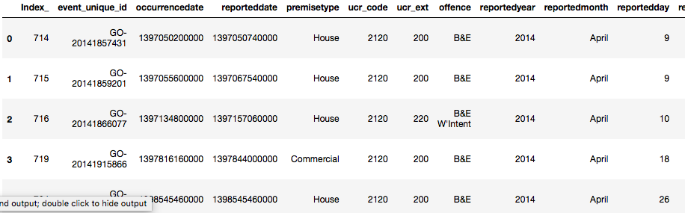
Data exploration
Example of data of ‘break and entrance’ crimes
Torondo_df dataframe only have 'break and enter' crimes from 2014 to 2019. The datafrane have the columns that we need to resolve this problem:
Neighbourhood column
Long and Lat columns for geographic coordinates
reportedyear columns for year
premisetype column for type of property

Slide 6
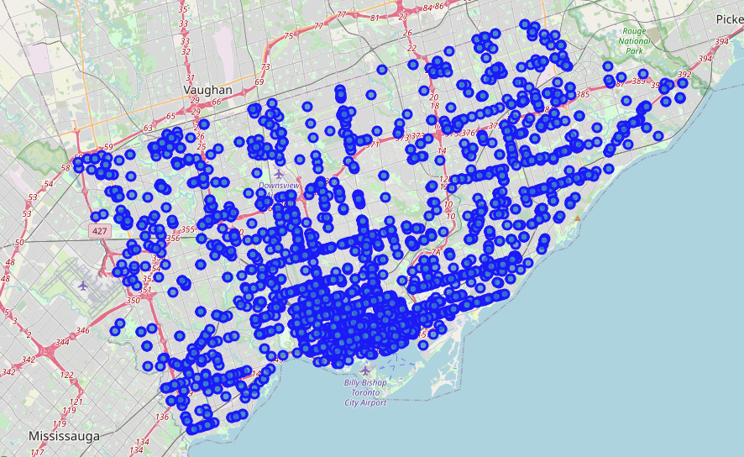
Data exploration
Map of ‘break and entrance’ crimes

Slide 7
Data exploration
Map of ‘break and entrance’ crimes

Slide 8
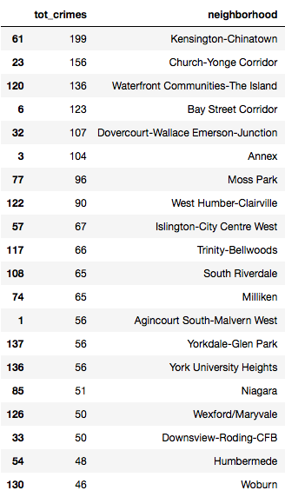
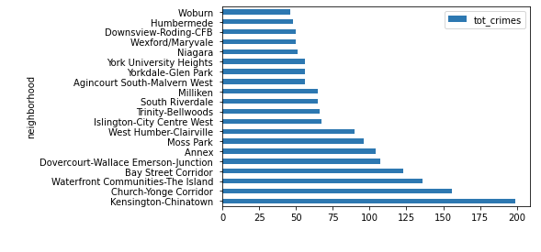
Data exploration
Crimes by neighborhood

Slide 9
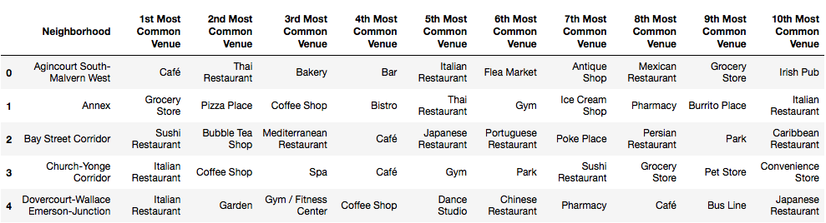
Clustering
Example of clusters for find most common venues by neighborhood

Slide 10
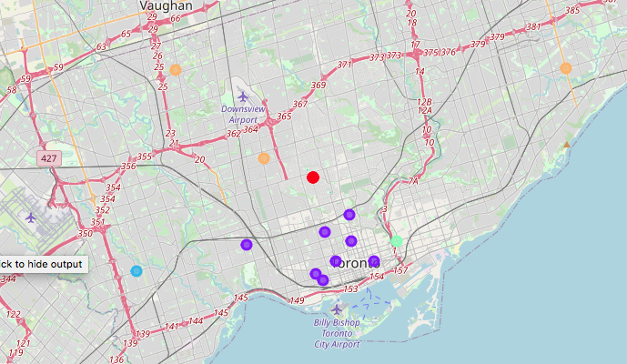
Clustering
Clusters map

Slide 11
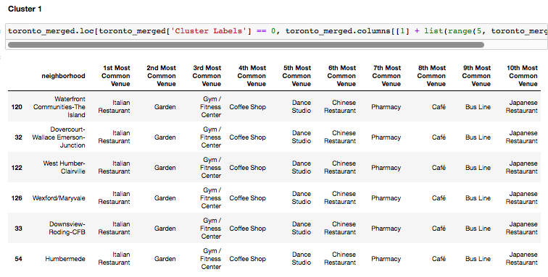
Clustering
Clusters 1

Slide 12
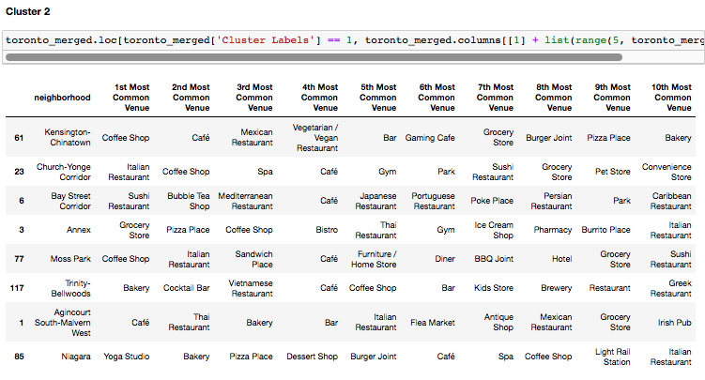
Clustering
Clusters 2

Slide 13
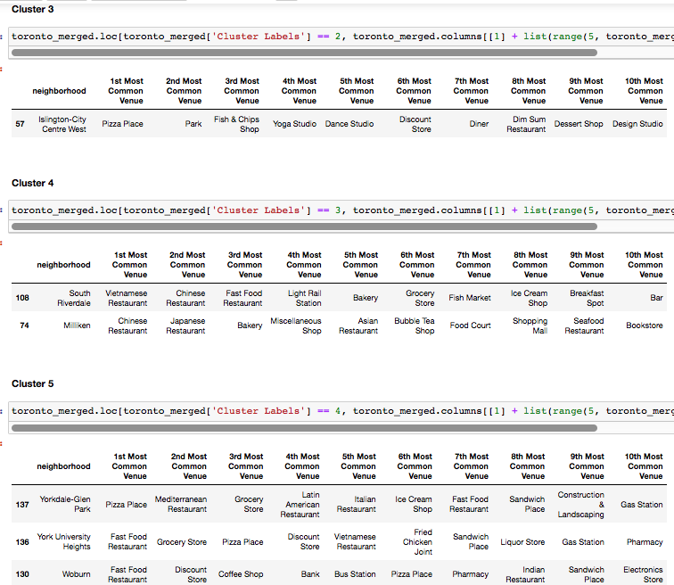
Clustering
Clusters 3,4 and 5

Slide 14
Conclusions
More interesting neighborhoods
Remember that the analysis cover the neigbourhoods with high number of break and entrance crimes.
Now we know: clusters 1 and 2 have a lot of categories most of these related to food like restaurants and coffe shops and other categories like gyms and stores.
So, this is a very interesting information that can be used addrresing to make a marketing campaig segmented to a kind of commerce: food related venues

Slide 15
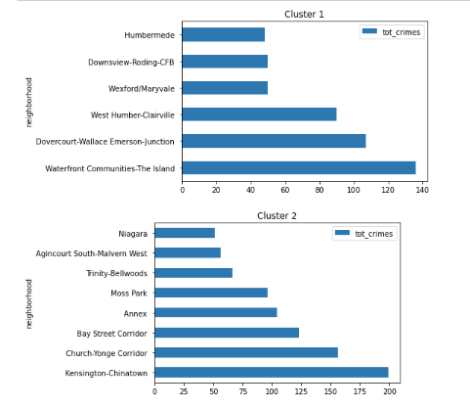
Conclusions
Now we know:
The difference between cluster 1 and 2 is to high.
Cluster 2 have almost double of cluster 1
Maybe, we will have more worried customers in neighborhoods of cluster 2

Slide 16
Conclusions
It is possible to find a high quantity of customers in the neighborhoods grouped in clusters 1 and 2
Customers in cluster 2 have a big problem with 'break and enter' crime in comparison with customers of cluster 1
In both cases there are comercial venues related with food.
It is possible to create a segmented comercial campaign based on the location and type of business.

